Slide 1

Title of Project CAR GAME Name of Students Yash Ashok Shirsath [Roll No 30] Nikhil Suresh Mohite [Roll No 21] Rohan Mahendra Ravidhone [Roll No 28] Aniruddha Kumar Mokashi [Roll No 22]
Jawahar Education Society’s
A. C. Patil College of Engineering, Kharghar
Department of Computer Engineering
Under the Guidance of
Prof. Prachi V. Wagade
Date:- 16/12/2021

Slide 2
Context :-
Introduction
Literature Survey
Proposed System
Results and Discussion
Conclusion
References

Slide 3
Introduction :-
The normal car game in which racing is included.
It is developed in C++ language.
Made for entertainment purpose.
Used C++ language to understand about it.
Create A Very Simple Car Game in C++ Console.
In this project we are giving details our project development game designing etc.

Slide 4
Motivation :-
This car game is designed in C++ Programming language.
It determines all basic commands, functions, syntax, structures and also the concept of file handling in C++.
The game ends whenever player’s car touches other car in the game.
So play it and score points as much as you can

Slide 5
Problem Statement and Objectives:-
For this game we are not using many programming languages, this project completed using only C++ Programming language.
These games have a feature that will keep people entertained.
One more feature of the game is that the game continues until your
game over.
And it also understands how much you scored.

Slide 6
Literature Survey :-
Survey of Existing System.
Many racing games are available today but we used our knowledge for making this game.
We used our personal knowledge of the games to discover existing applications and search engines to discover more of them .
And tried our best to make the as enjoyable as possible.
We are trying to our game is become more realistic

Slide 7
Limitation Existing system or research gap:-
Retro-style racing games put fun and a fast-paced experience
above all else, as cars usually compete in unique ways.
A key feature of arcade-style racers that specifically distinguishes
them from simulation racers is their far more liberal physics.
This racing game simply remove the precision and rigor required from the simulation experience and focus strictly on the racing element itself.

Slide 8
Mini Project Contribution:-
In this project the contribution of the contents we have used C++
as our main language we divided our work according to the requirement of our project there are no specific roles as whenever needed.
This mini project contributes to old Retro car racing game which is mainly for fun and to increase competitiveness in player for purpose of fun .

Slide 9
Proposed System :-
Used laptop or computer as hardware.
Used Dev C++ as software.
This game is for entertainment purpose.

Slide 10
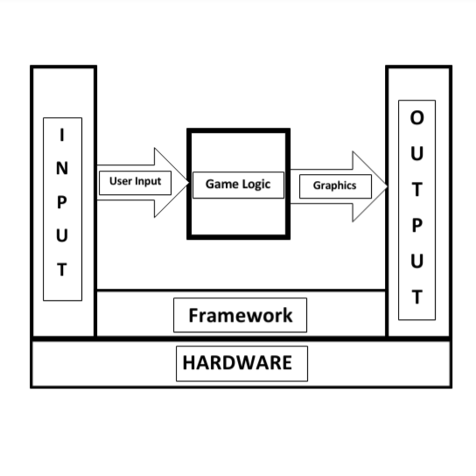
Proposed System :-
Architecture/ Framework:-

Slide 11
Algorithm and Process design:-
Now let us discuss each method in details, In this topic we will see what functions we have used in creating game.
GetStdHandle
STD_OUTPUT_HANDLE
gotoxy
SetConsoleCursorPosition
Setcursor
drawBorder
genEnemy Etc.

Slide 12
Details of Hardware and Software:-
Hardware :- A Standard Laptop or PC.
Software :- Dev-C++ 5.11 Version IDE For Compiling and
Running Code.
Command Prompt For Playing Game.

Slide 13
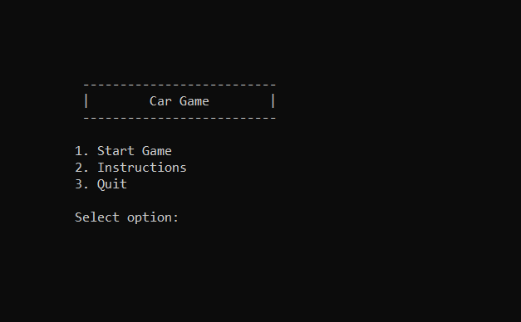
Results and Discussion :-
First photo showing for interface of starting of game.

Slide 14
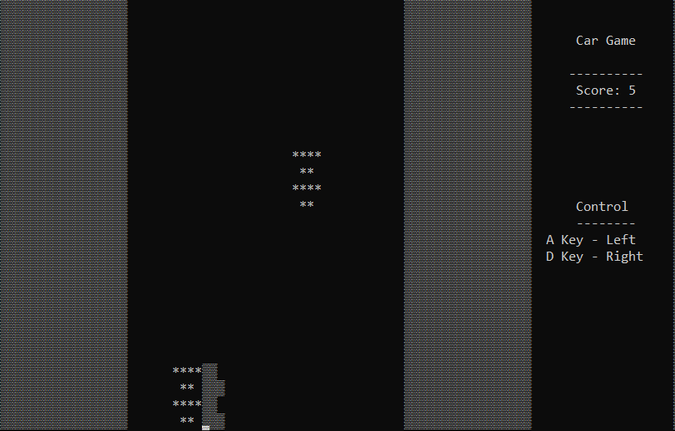
Second Photo is showing for playing game

Slide 15
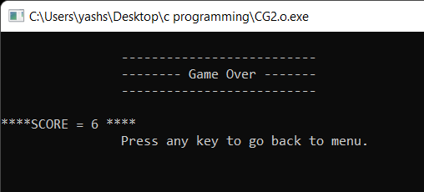
Third photo is showing for score and ending of game

Slide 16
Conclusion :-
Now you can enjoy car gaming
This is a C++ Project of car game, we have used procedure oriented method to design this project of car game.
In this project we use programming concepts like switch case, call by reference, library function and many more functions etc.
We successfully made Console Car Game by implementation of C++.

Slide 17
References :-
https://www.geeksforgeeks.org/c-plus-plus/
https://www.google.co.in/
https://stackoverflow.com/
https://cpp-programming-tips.blogspot.com/
https://www.tutorialspoint.com/cplusplus/index.htm
https://www.programiz.com/cpp-programming/function

Slide 18
